Slide 1
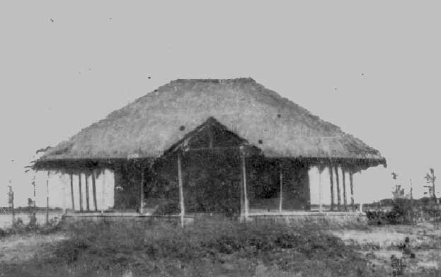
Vivekananda Sevakendra-O-Sishu Uddyan
Made by the Community for the Community
VSSU at inception 1986

Slide 2
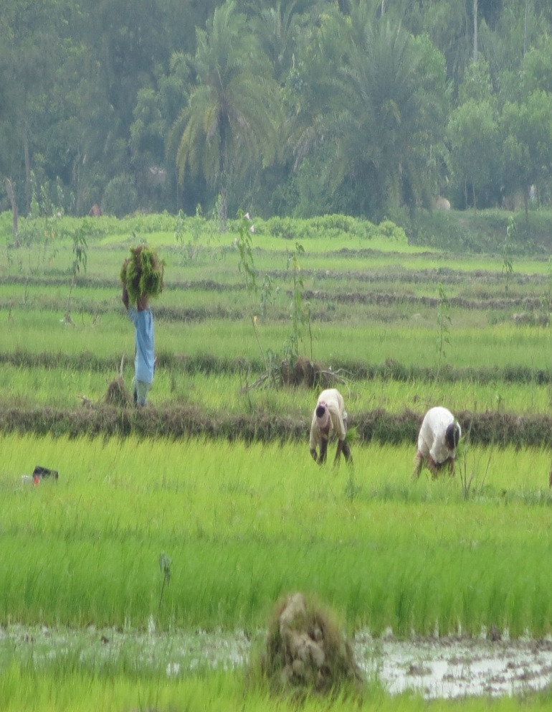
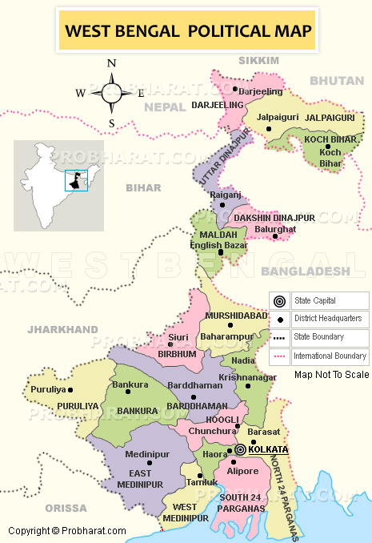
Where we are working
South 24 Parganas, Sunderbans, West Bengal - India
Population: 8.1 million
Out of which 74% live in rural areas
Activities:
Agriculture, Fisheries, micro & small enterprise
VSSU’s working area

Slide 3
History of the organisation
One villager died without treatment, and we collected some money for his funeral. After the funeral, some money was in excess. We realized that if we had collected the money for his treatment, he might still be alive.
This motivated the villagers to start VSSU in 1983. It is located near Sunderbans, West Bengal, India.
What we have realized:
Many things are happening around us.
We can watch and wonder. But if we act at the right time,
we can make a difference .

Slide 4
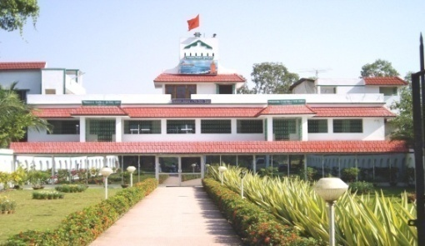
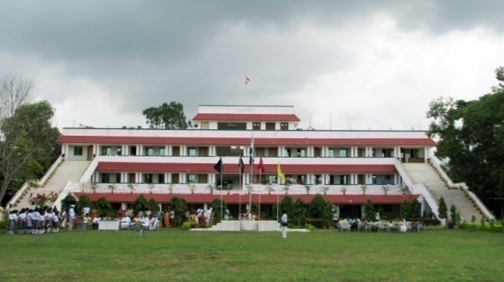
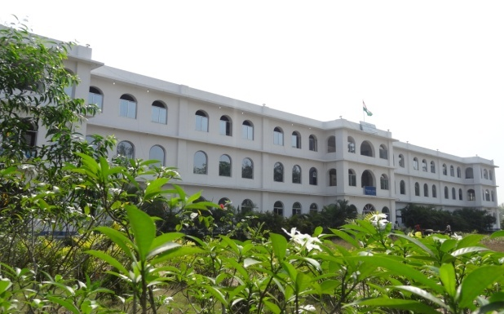
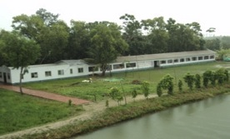
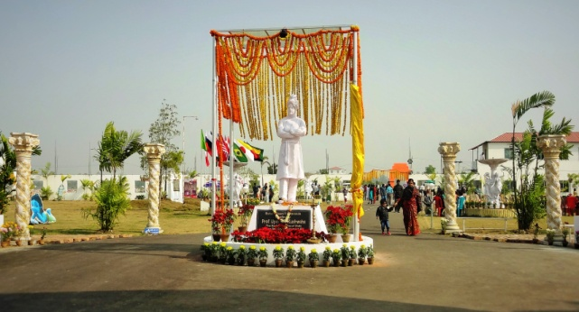
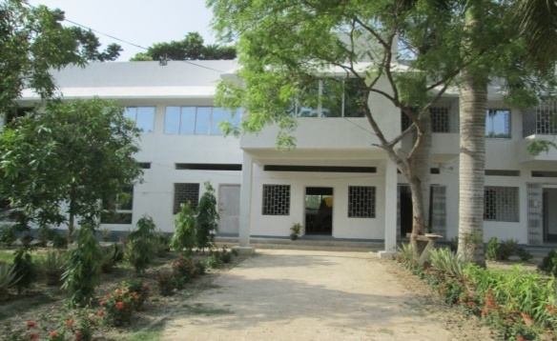
Vision :
Community Development
through Community Recources
Mission :
Poverty alleviation & Human Dev. through Micro Finance
Objective :
Enterprise Development for Community Development
1998-2002
2003-2007
2008-2011
ASHOK NILAY
For Community Development
Health, Education, Environment
THE OCEANIC LIBRARY
for Livelihood promotion
Training & Skill Development
VSSU MICRO-FINANCE H Q
For Economic Development
Savings, Credit, Insurance
2007-2008
2011- 2013
2011-2012
DESTITUTE CHILDREN HOME
Mostly Child labor
VSSU INSPIRATION CENTRE
Entrance of VSSU
VSSU - INTERNATIONAL SCHOOL
English Medium

Slide 5
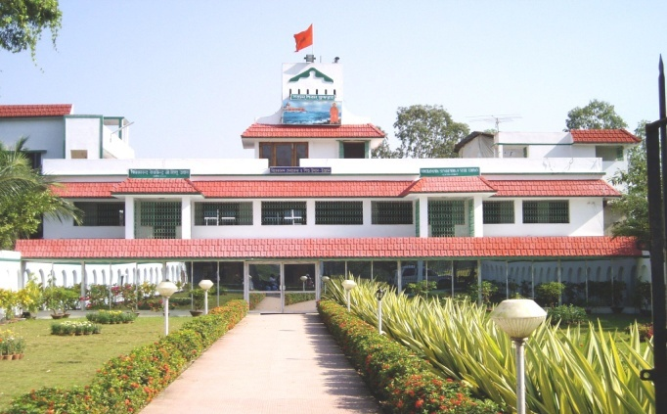

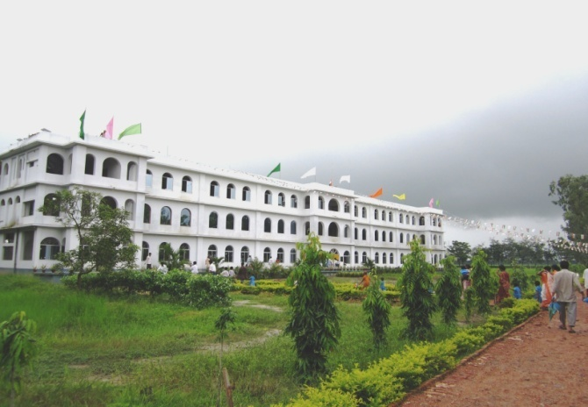
VSSU’s Dept. wise Activity at a glance
VSSU MICROFINANCE
For Economic Development
JEEVIKA FOUNDATION
For Livelihood Promotion
ASHOK NILAY
For Social Development
Savings
Credit
Insurance
7 in 1 facility
Joint development initiatives
Savings based credit program
15 Acres Land donated to GOI ( H.S)
Home for Destitute Children
Pre Primary education
VSSU - International School
1500 Sanitation & 2 Medical Centers
2km +7 km Link road
140 Km Tree Plantation
The Oceanic library
Honey Processing Unit
Renewable Energy Centre
Training & Skill Dev. Centre
B.ED College (approved)
Agri-based Rural Eco-Tourism
Last 26 years we have accomplished all of these activities without any External Grant Support.
We can arrange land for fulfillment of our dream seeking collaboration with other institutions.

Slide 6
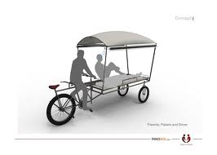
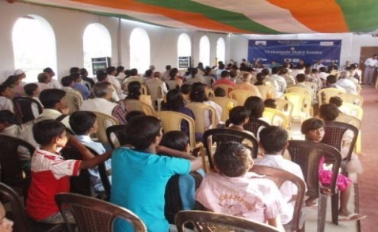
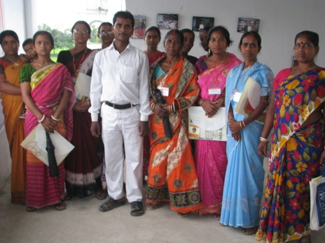
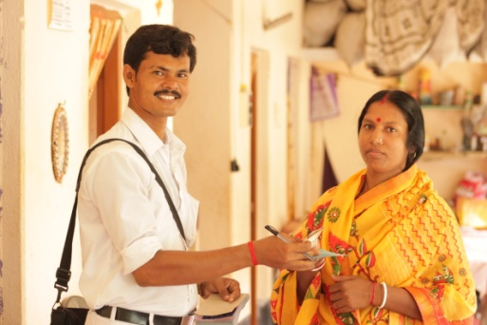
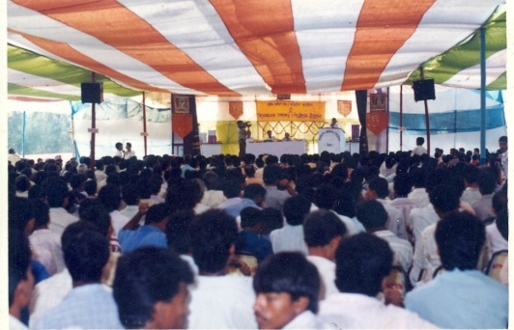
How we started the Micro-credit Program
One day I was going to our train station on a rickshaw van. The driver told me that he paid rupees 5* per day to his owner. At that time, he was ill and not able to pay the rent. I asked how many years he rented the van. He said 22 years. I calculated that in 22 years it would be about Rs.40,000.
Then I asked if I give you a van can you pay daily Rs. 5, if not, the van will be mine. Then, I went to a shop, bought a van, and gave it to him. we gave 300 vans our area. Then we started savings based credit program. At present our cumulative savings is Rs.840 million.
What we have realized is:
“Small savings can create a big nation.”

Slide 7
Our Micro credit Program
Small scale savings and loans:
To Individuals & Groups* (Groups for only women)
100% loan from savings
74% loans for business purposes
Door to door services through 10 Branch Offices
product : Daily, Weekly, Monthly, One time (FD)
Loan product : A= Agriculture B= Business
C= Consumption D=Development E=Enterprise

Slide 8
VSSU Innovative Delivery Mechanism
Individual lending, no grants/external funds
70 -75% loans guaranteed by depositors
Local personnel: 125 employees (Micro-fin - 54 staffs)
Credit + Prog. (Only for Our Microfinance Client - 7 in 1 Facility)
Lending to 19 NGO to start up finance (117 lakhs = 11.7 Million INR)
Balance financial and social interventions for better impact

Slide 9
VSSU’s Micro credit at a glance ( Mar - 2016)
Number of villages served 710
# of Branches 11
Cum. Members 1,30,976
Cum. Savings corpus from SHGs 106.69 Cr.
Present Active members 19,875
Cumulative Loans Disburse 57.17 Cr
# of Current Loans 6,150
Loan Outstanding 7.85 Cr.
% Loan Recovery 96.5 %

Slide 10
Difference between
VSSU’s Savings Based Credit | Conventional Credit
Clients can repay at any time Loan amount depends upon client’s dream Bigger size loan possible with Collateral More Flexibility In rules Clients can save more as per choice More equity more Confidence | Clients can’t repay at any time Loan is structured & not as per Client’s Dream Bigger loan not possible even with collateral Less flexibility in rules Clients can’t save more as per choice No equity and less confidence
Organisational side
Working with Savings Tailor-made as per customer choices Savings Based Credit , margin 5% Less Risk because of Savings/Borrower’s Stake | Working without Savings Readymade - as per structured loan Borrowing based credit with margin less 5% More risk, absence of Savings/borrower’s Stake

Slide 11
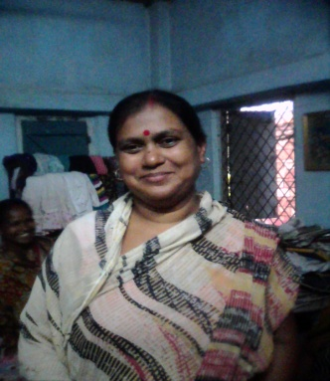
Case study: Success Stories
Name Of the client : Subhra Naskar ( Group Leader); Age: 51 Yrs.
Occupation : Saree Business; Loan Cycle: 7 of Rs.15,000/-
Branch : Laxmikanta Pur Average income 6000-7000/-p.m.
First loan of Rs. 5000/- seven years ago to start a small Saree ) business from her house.
Then she started expanding her business. Later on she took loans in several times for several purposes like tailoring machine purchase, raw material purchase etc .Gradually the income from the business increased and she made an individual identity in her family by contributing in the monthly expenses . She brings up her two daughters. The increased income has helped her to make two monthly savings a/c also with VSSU and to marry off her elder daughter .After repaying of the previous loans recently she has taken a loan Rs 15000/-for repairing their auto rickshaw, which helped her son to become financially established. VSSU has made another self dependant Youth. Initially her Family was not able to send her daughter to school but later on as her income increased she was able to send her daughters to school for education. Thus VSSU is helping to the community to become self reliant.

Slide 12
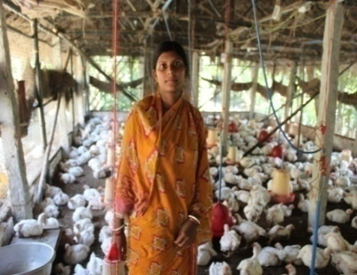
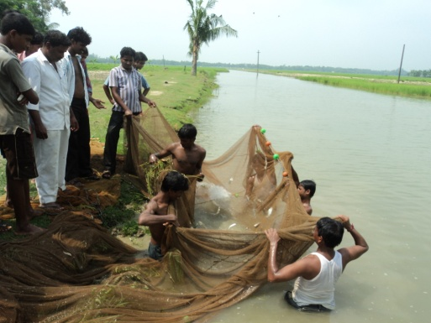
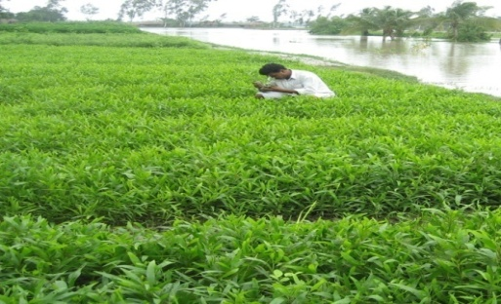
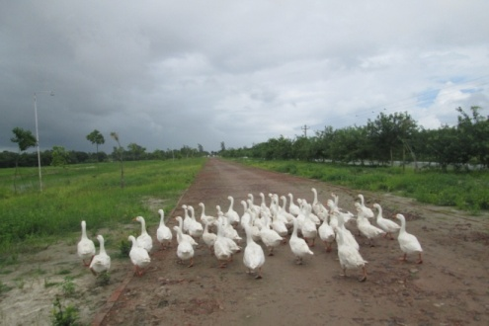
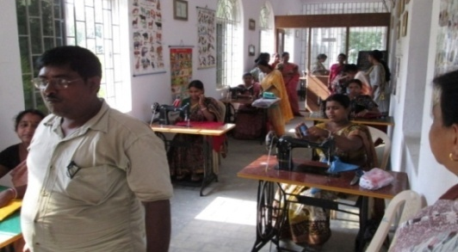
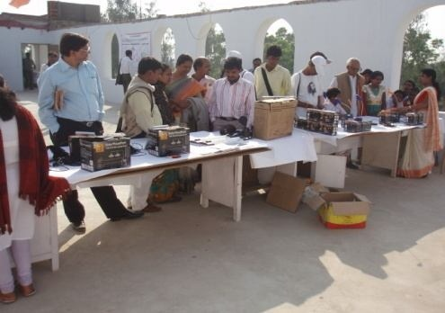
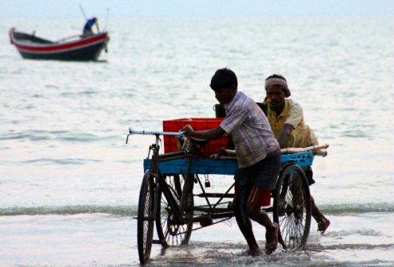
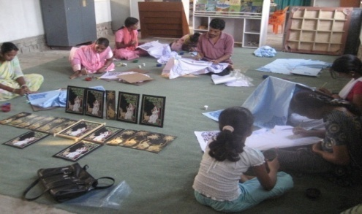
Started Livelihood Promotion to Strengthen Micro credit
Eco-Tourism program
40 Acres Canal (leased from State Govt.) for fishery, duck cultivation
& water for single to multi-cropping.
Poultry
Fish cultivation
Nursery prog
Duck cultivation
Tailoring prog.
Solar panel
Fish net making
Handicrafts

Slide 13
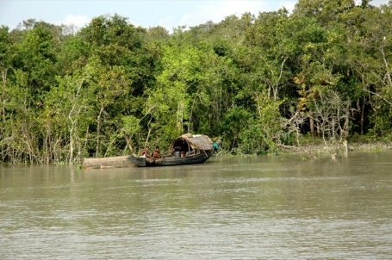

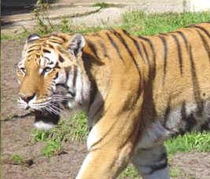
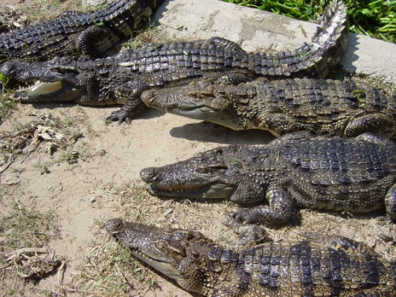
Rural Eco-Tourism Projects to Expand Employment Opportunities
Started an agri-based rural eco-tourism project which will provide local women a way to demonstrate and market their handicrafts.
  This project will provide more employment opportunities and strengthen microfinance.
  Tourism program provides training and Sundarban visit arrangements. Participants/Tourists can be local or international
  Gateway to Sundarbans, the largest mangrove forest and deltaic region in the world. Also famous for Royal Bengal Tigers.

Slide 14
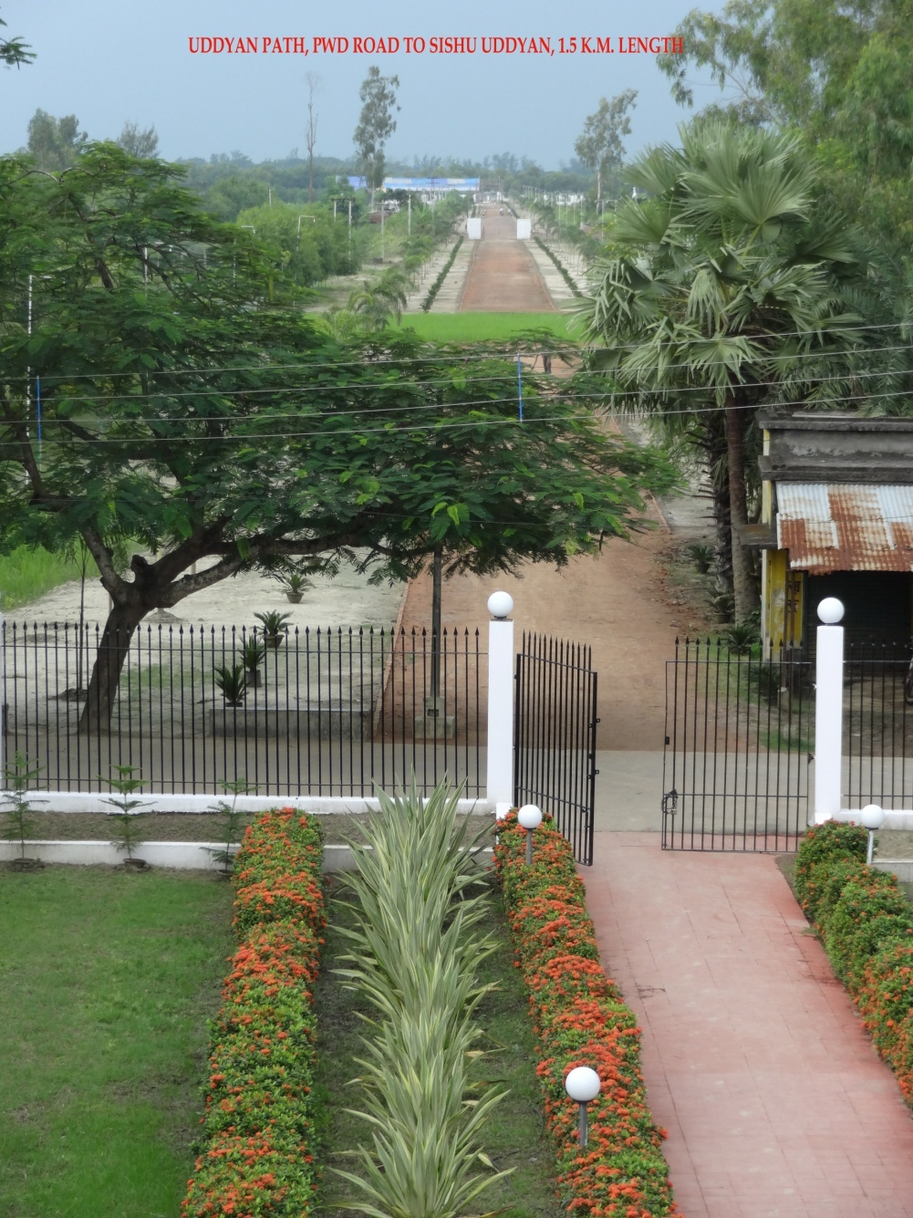
VSSU Tourism Site

Slide 15
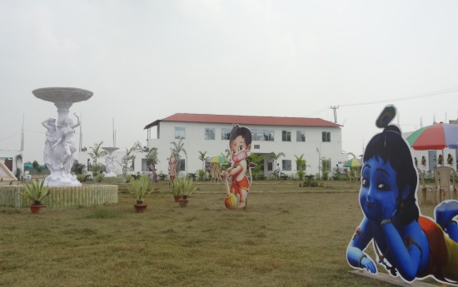
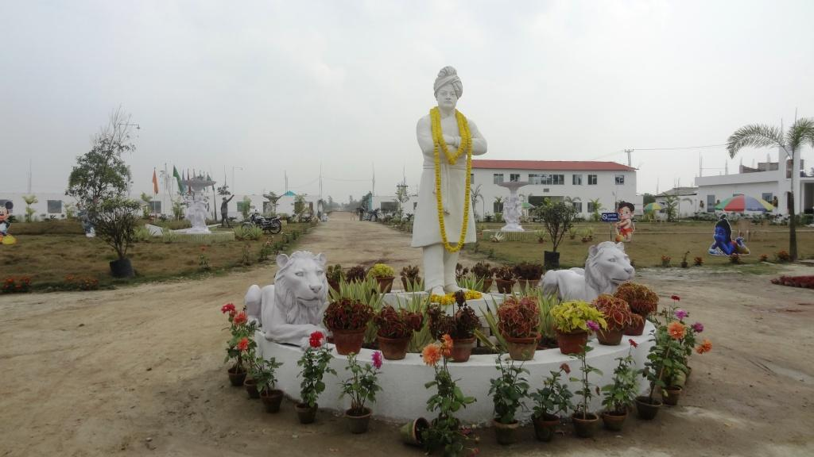
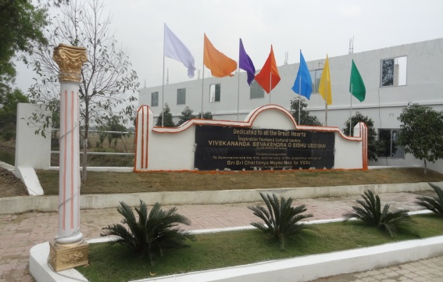
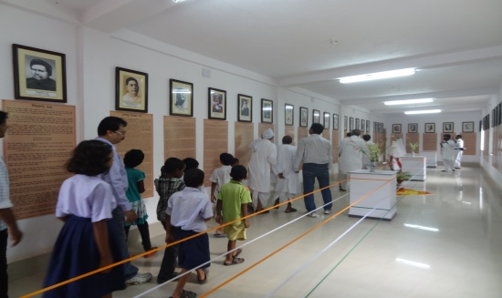
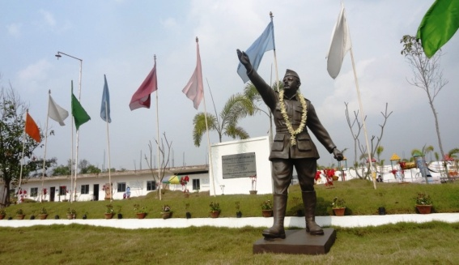
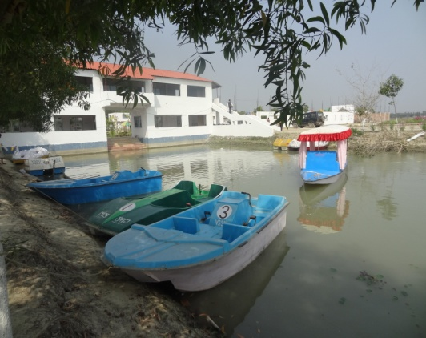
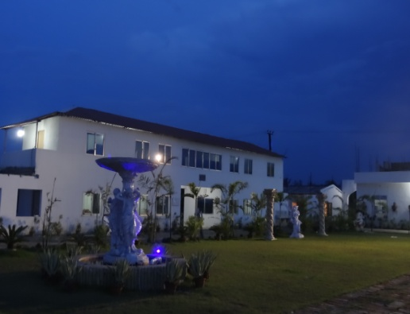
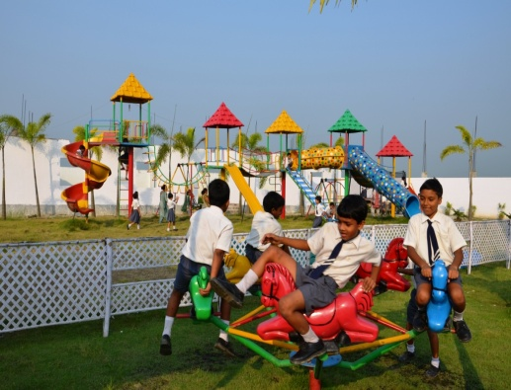
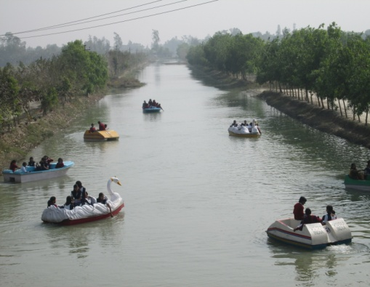
Agri - Based rural Tourism for Employment generation
VSSU has recently started this rural tourism initiatives on 100 acres of land which include the followings…
Kids Amusement Park Great men Gallery Cultural complex Fisheries & Nursery
Water sports & amusement Guest house Multi gym etc.

Slide 16
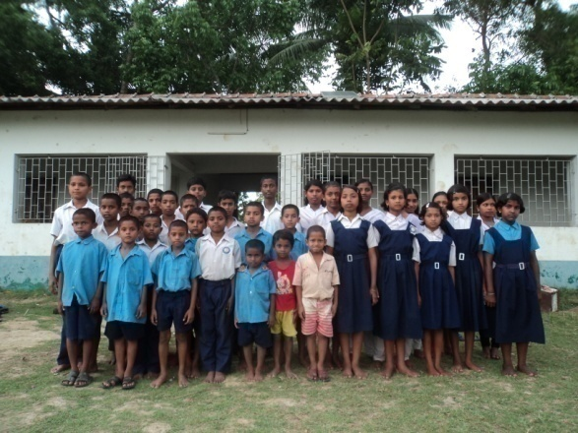
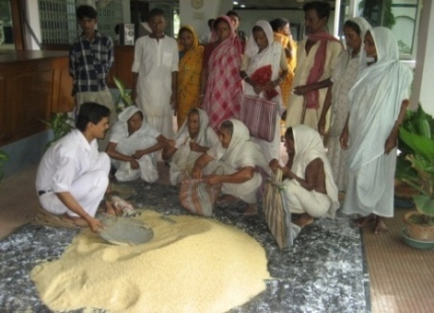

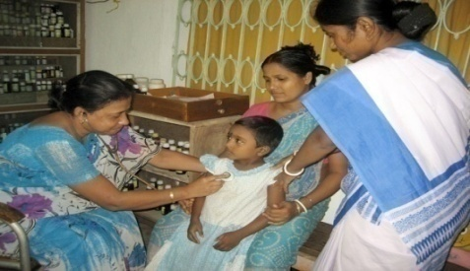
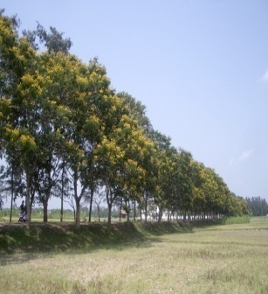
Micro-credit Profits are used for Community Dev.: (100% Subsidized by VSSU)
Senior Citizen Care Program 960 family per year
50 Destitute Children in Orphanage Home
Scholarships for 260 students
Two homeopathic medical clinics & Awareness prog
140 km. roadside tree plantation (600000+ trees )

Slide 17
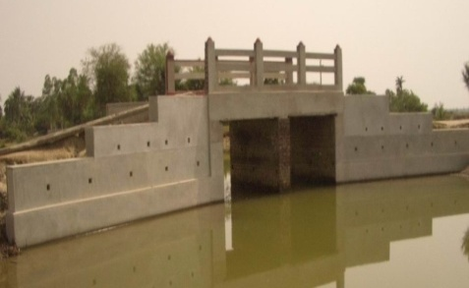
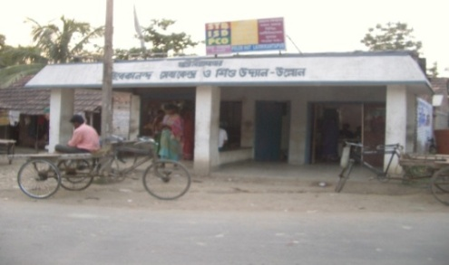
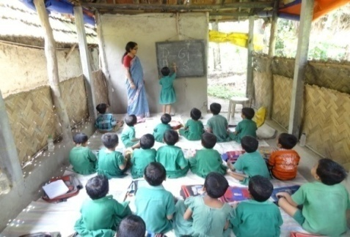
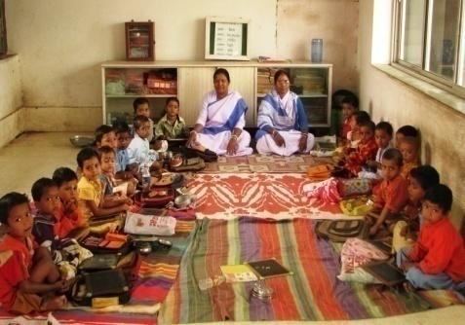
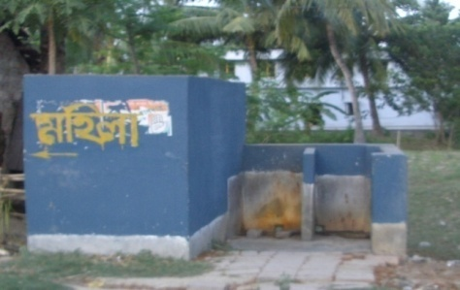
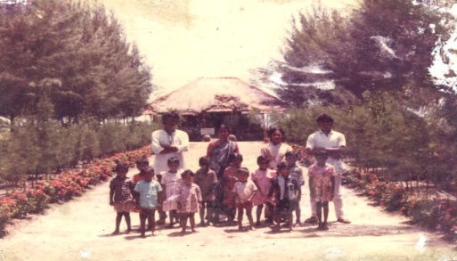
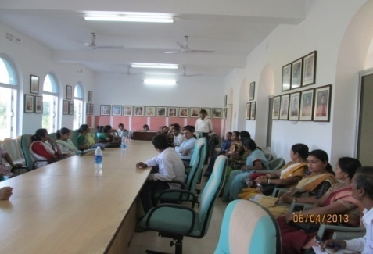
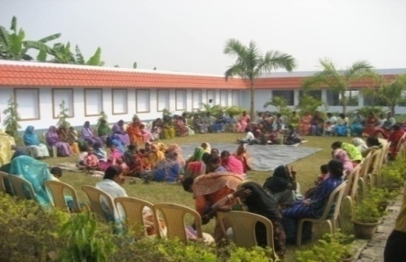
Micro-credit Profits are used for Community Development (Joint Initiatives 50:50)
Community Infrastructure Development ( Road , canal, culvert, rest shades, tube well etc)
Free Pre-Primary Education in 10 Creches
680 students
About 1500 interest free sanitation loans to the women.
Training and skill development for women
Exposure visits for individuals
and groups clients

Slide 18



Education for Rural Development
Competitive exam for government jobs
VSSU International School Higher Secondary School CBSE The Oceanic Library & B.Ed College
Education for Economic Upliftment
Government has already approved 520 million INR for (JNV) this project
600 meritorious students will get facility free of cost
120 teaching & non teaching staff

Slide 19



International Brotherhood Conference – 2012
27th September – 2nd October
150th years Birth Anniversary of Swami Vivekananda
25 years of VSSU & 10th Years of MAA’s arrival …
In presence of
AMERICA AUSTRIA BANGLADESH BHUTAN BRAZIL CHINA FRANCE INDIA ITALY JAPAN MALAYSIA NEPAL NETHERLANDS & RUSSIA
This conference was organised to convey our love , respect & gratitude to each country ,
Citizens & religions of the earth.

Slide 20



150th Birth Anniversary of Swami Vivekananda
10th Years of MAA’s arrival
25 YEARS OF VSSU
International Brotherhood Conference – 2012
27th September to 2nd October
In presence of
AMERICA AUSTRIA B ANGLADESH BHUTAN BRAZIL CHINA FRANCE INDIA ITALY JAPAN MALAYSIA NEPAL NETHERLANDS & RUSSIA
14 COUNTRY FROM 4 CONTINENT DELEGATES HOSTED THEIR NATIONAL FLAG
This conference was organized to convey our love , respect & gratitude to each country, and for the
citizens & religions throughout the world.

Slide 21


Recognition and Awards from India
Member Working Group , Planning Commission, Gov. of India,
12th Five yr. Plan 2012-17, (Outreach of Institutional finance, Cooperatives , Risk Managements )
Basic Study Report (India’s Largest Micro Finance Org, Innovative Microfinance Services)
“The Case of Vivekananda Sevakendra–O-Sishu Uddyan” Prepared by Gitali Thakur
(Student)
India Institute of Management, IIM

Slide 22


Recognition from United Nations
VSSU was granted “Special Consultative Status” by the United Nations (ECOSOC) in 2011
“ To support the holistic development of the Indian community in a self sustainable manner, and in particular, through microfinance project & various community development programs”

Slide 23
Recognition
World Bank Study Report: 56 pages
“… International Microfinance can learn from VSSU.
It is entirely local, works with men as well as with women, conducts most of its business with individuals rather than with groups, has built its capital base on client deposits and has taken no donor funds, has received no ‘capacity-building’ advice or training, offers products that are essentially savings plans with loans as an optional service, and derives all its income from those loans which are priced at only 24% a year …
VSSU regularly makes surpluses big enough to fund an array of charitable work and to re-invest in its own growth”
(www.Microfinance gateway.org/static/2789.htm)
Stuart Rutherford
World Bank Consultant

Slide 24


Recognition and Awards
Social Performance Report: 26 pages
by EDA/M-Cril, Argidius & the SEEP Network
“VSSU is a very innovative MFI, with a unique business model: using the Community’s own resources in order to foster economic & social development, through small business growth and community work . At present, VSSU is undergoing hard times, mostly due to regulatory problems and lack of funding. We believe this is only temporary. More importantly, VSSU needs to make sure that its long term plans remain realistic and its leadership adapts to the growing size of the organization.”

Slide 25



Slide 26



Kapilananda Mondal was requested to write an article on “Future of Micro Finance 2020” by Convergence Barometer 2014, which was published in 202 websites world wide and 10000 in hardcopies worldwide in French & English Version. VSSU’s innovative Micro finance Practice was also published in Award booklet of Convergence Barometer as special entry

Slide 27


India Dev. Coalition of America (IDCA) Hero 2015:
Kapilananda Mondal

Slide 28








COMMENTS FROM NOTABLE PERSONS
READ feels very blessed to be working in Ullon and with its inspirational leader, Kapilananda Mondal, who truly walks in the shoes of Gandhi. - Senator Omer L. Rains, California, USA | 2013
Many thanks for following up and for filling in what you have been able to accomplish since 2003. – Bill Drayton, Chair Member of ASHOKA INNOVATORS FOR THE PUBLIC | 2013
Mr. Mondal is humility personified, low key ,polite attentive with a constant smile bright eyes at the same time ,he is like a walking nuclear power station with a brain that always seems to be booming. Ideas and projects poping up in a steady stream. Anders Edgren, Senior Producer, Swedish Educational Broadcasting | 2012
What I am trying but Kapil has already achieved, 100% loan from savings – Nobel Laureate Prof. Md. Yunus | 2003
International Microfinance can learn from VSSU … World Bank study report Stuart Rutherford, Consultant, | 2002
I sincerely hope that the micro finance world will learn of and learn from VSSU – it has many many lessons for us all… Graham A N Wright -Micro Save Africa | 2001
Really you are doing marvelous job for the society… 2012
Harish Handey - Magsaysay awardee
Of course I will visit your organisation to see your activities how you are doing 2012
Without support from outside… M K Narayanan Governor-West Bengal

Slide 29
Kapil Mondel with Nobel Piece Prize winner, Mohammed Yunis, founder of Grameen Bank.

Slide 30







Exposure & Invitations From Abroad
 | COUNTRY | YEAR | PROGRAMME | SPONSORED BY
 | DHAKA BANGLADESH | Mar. 2002 | EXPOSURE VISIT GRAMEEN BANK ASA , PROSIKA & BURO TANGAIL | SIDBI GOVT. OF INDIA
 | AMERICA | Nov.2002 | MICRO CREDIT SUMMIT- NEW YORK BOSTON OXFAM OFFICE PRESENTATION ASHOKA OFFICE VISIT- WASHINGTON | OXFAM AMERICA
 | ENGLAND | NOV 2002 | BBC OFFICE & CAMBRIDGE UNIVERSITY | OXFAM AMERICA
 | DHAKA, BANGLADESH | Mar 2003 | MICRO CREDIT PROGRAM, ORGANIZED BY BRAC | BRAC, BANGLADESH
 | BANGLADESH | OCT.,2003 | ASHOKA GRAMEEN INTERNATIONAL DIALOGUE PROGRAMME | ASHOKA, USA
 | FRANCE BELGIUM THE NETHERLANDS, ITALY, AUSTRIA GERMANY | FEB.,2004 | ICT CONFERENCE ON MICRO CREDIT | PLANET FINANCE, FRANCE
 | PAKISTAN | SEPT.2004 | ICT CONFERENCE ON MICRO CREDIT | PLANET FINANCE, INDIA
 | SOUTH AFRICA & SAUDI ARABIA | FEB.2005 | EXPOSURE VISIT | SIDBI GOVT. OF INDIA

Slide 31







Exposure & Invitations From Abroad
 | BANGLADESH | JUL. 2006 | INVITATION BY BRAC, & BURO TANGAIL | SIDBI GOVT. OF INDIA
 | MOSCOW, RUSSIA | OCT.2006 | FOR COLLABORATION | INDIVIDUAL DONOR DEBASMITA MOULIK
 | THAILAND | FEB.2007 | BAAC (BANK FOR AGRICULTURE & AGRICULTURAL COOPERATIVES) | SIDBI GOVT. OF INDIA
 | BANGLADESH | MAR.2007 | COLLABORATION PROGRAMME WITH BRAC | SIDBI GOVT. OF INDIA
 | NEPAL | FEB.2008 | READ NEPAL LIBRARIES | READ GLOBAL, USA
 | AMERICA | JUNE 2010 | UNITED NATIONS SPECIAL CONSULTATIVE STATUS | VSSU - INDIA
 | AMERICA | FEB 2011 | UNITED NATIONS SPECIAL CONSULTATIVE STATUS | VSSU-INDIA
 | AMERICA | AUG 2013 | UNIVERSITY & COLLEGE PRESENTATION | University , College & The Boston pledge

Slide 32













Opportunity to lectures at following Universities & colleges
U S A From 29th August to 17th September 2013
Terra Haute – Indiana State 1st sep
Bharat Sevashram Sangha Chicago 2nd sep
Main Campus - Purdue University 4th sep.
Purdue University – Calumet 5th sep.
Hindu Temple Greater Chicago 7th sep
Ohio-The college of Wooster 9th sep
The College of Wooster I class lecture 10th Sep
Read Global USA & Founder House 11^{th Sep}
Sierra Nevada College 12th sep.
Sierra Nevada+ 2 Class Lecture Lake Tahoe 13th Sep
Fletcher School of Law &Diplomacy-
Tufts University 14^{th Sep}
MIT-Massachusetts Institute of Technology 15thSep.
United Nations office for future prog 16th sep
Boricua college – New york 17th sep

Slide 33






Advertisements & Leaflets published by American organizations to welcome students , followers, listeners to Meet Mr. Kapilanannda Mondal during his visit from 28 Aug to 13 sep 2013.

Slide 34


Slide 35


Slide 36






INTERNS
GUESTS & EXPOSURE VISITORS
50+ interns from 32 countries

Slide 37
New Model of Micro-finance
A poor man is sanctioned a loan of Rs. 10000/-
In the conventional micro credit Model man has to pay Rs. 250 per week / Rs. 1000 per month and no margin money was taken after one year the loan is repaid fully & the poor man is landed with no deposit or Savings. Generally it takes 11 months time.
Loan Amount: Rs.10000/-
Margin Money: Rs 1000/-10%of Loan amount at Disbursement time on which interest @10% will be paid)
(for creating sense of responsibility & involvement) if collateral interest will be deduct depends on…
Repayment Period: After harvesting / at any point of time.
Repayment Amount: Full or Part payment (optional) that depends on Client’s Income/choice
Payment of Interest: Rs. 200 pm. @ 24 % reducing
Savings: Depending on the Savings option with credit plus facility a client chooses the Loan Can be
set off as under
3 % savings / Pm i.e. 300 for a loan of Rs. 10000/- + int. pay monthly Period of setting off 27 months
2 % savings / Pm i.e. 200 for a loan of Rs. 10000/- + int. pay monthly Period of setting off 39 months
(Interest @4-10% p.a. is payable on deposit )
(Loan Interest @ 24 % for one year, 21% for 2nd year , 18% p.a. for 3rd years & onwards for clients with regular savings)

Slide 38

“All the wealth of the world can not help
one little Indian village if the people are not
taught to help themselves” - Swami Vivekananda

Slide 39

I am grateful to the Community people
and to all of you for the invitation and the support
Please visit www.vssu.in
our organization in West Bengal, India
Email vssu.in@ gmail.com +91 97357 06439
Namaskar

