Slide 1
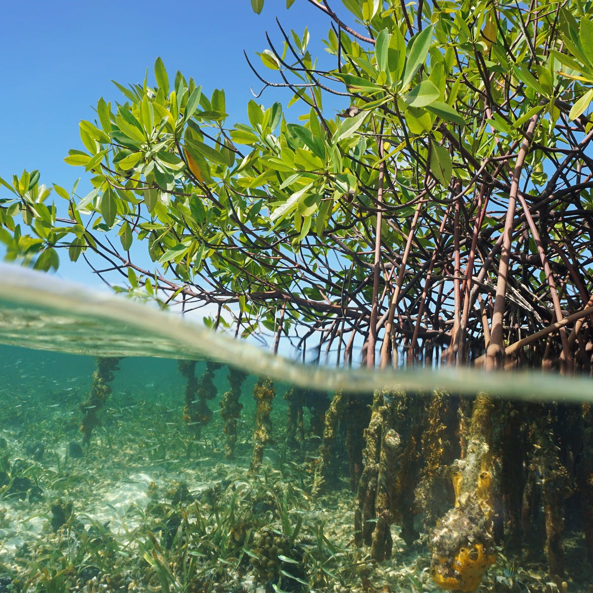
Technology for Protection of Coastal Areas & Earthen Embankments Through Vegetative Solutions
Presented By : Sri Kapilananda Mondal, ( Ashoka Fellow), Former Member Planning Commission , Agri Division , 12th Five yr plan , GOI Vivekananda Sevakendra -O- Sishu Uddyan

Slide 2
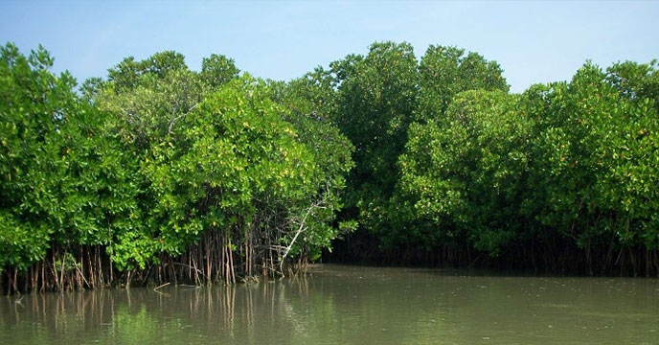
“Mangroves are magical forests where we discover nature’s secrets. They straddle the connection between land and sea and nature and humans. Mangrove forests nurture our estuaries and fuel our nature-based economies”.
ANNE BIRCH
Marine Conservation Manager, TNC Florida

Slide 3
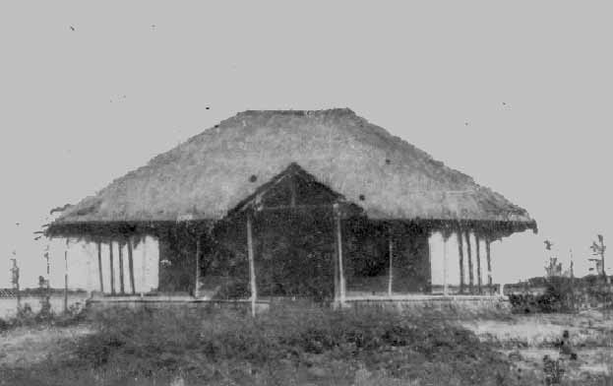
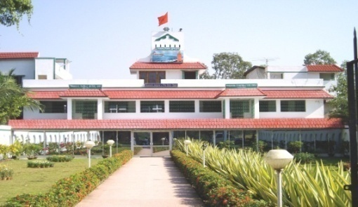
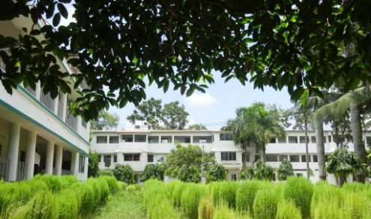
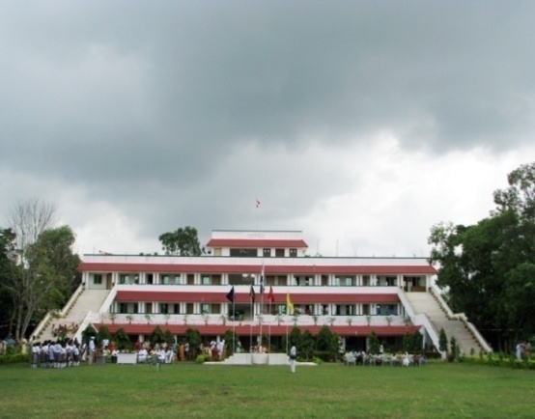
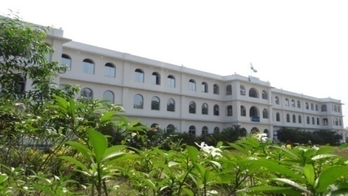
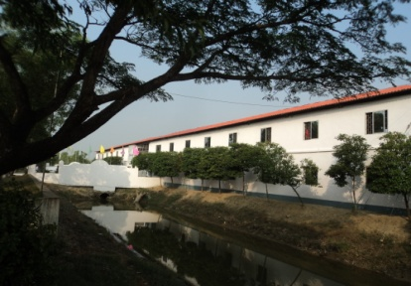
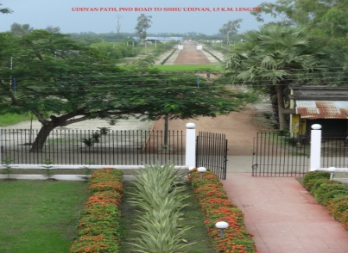
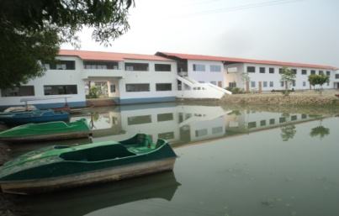
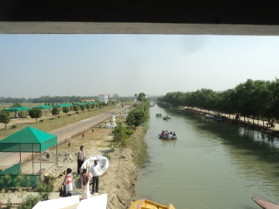
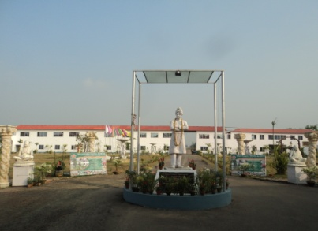
Vivekananda Sevakendra -O- Sishu Uddyan
VSSU Awarded “Special Consultative status” by United Nation’s ECOSOC
Vision :
Community Development through Community Recources
Mission :
Poverty alleviation through Education & skill dev.
VSSU -1986 at Inception
VSSU HO VIS CBSE SCHOOL JNV School ( CBSE) MOHRD ANNCE B.ED. COLLEGE
VSSU is a social developmental organization working since 1986 in 910 villages of 10 blocks of South 24 pgs adjacent to coastal Sunderban with 175600+ direct beneficiaries & 151 dedicated staffs . In 2011 VSSU has been awarded “Special Consultative Status’ by United Nation (ECOSOC) “to support the holistic Development of the Indian community in self Sustainable manner in particular through Micro Finance program with various community development programs’ viz. Crèche Schools, B.ED College , Polytechnic Colleges, Library, PMKK & DDUGKY Skill training center, Health center, Social forestry & Mangrove plantation & conservations progs etc.
Looking forward for support & advice from National & International developmental Organizations / CSO/ NGOs.
Inviting Collaboration for programmes like poverty Alleviation, Women empowerment , Skill training & Education for all , Health, sustainable Environment etc. ..
Skill Training campus Gateway of smart village Residential Campus ( #700) Rural Tourism & Cultural Centre POLYTECHNIC College
Your are cordially welcome to visit us
RSVP : + 91 3174 27451 / 91 97357 06439 / 9609 145 459 , Email : vssu.in@gmail.com , www.vssu.in

Slide 4
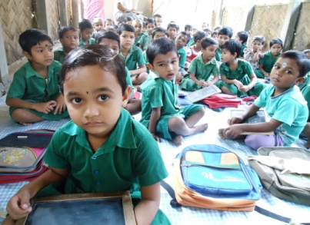
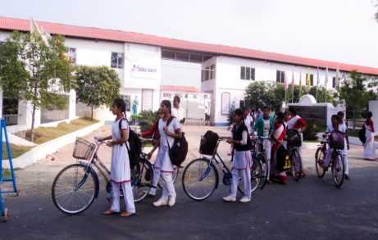
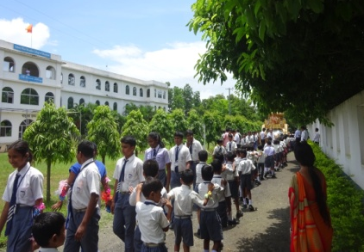
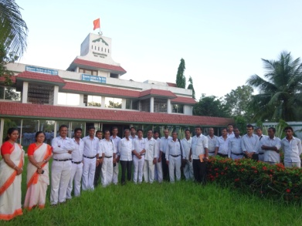
About VSSU
VSSU is a Social developmental organization , registered under societies registration act of 1961 of Govt. of West Bengal , working since 1986 for the coastal Sunderban area.
VSSU is working primarily working for Poverty alleviation, Environmental Sustainability , Education Skill development and alternative livelihood programs in 910 Villages of 10 Blocks of Sunderban police district and directly impacted lives of 175000+ vulnerable families .
VSSU has been accredited With “Special consultative status “by UNITED NATIONS ECOSOC “ to support the community in a holistic manner.”
VSSU’s innovative approach have been praised by WORLD Bank, Noble laureate MD Yunus , In addition 350+ interns / visitors from 56 countries of 5 continent visited VSSU and experienced our holistic developmental approach for the underprivileged.
VSSU is running 10 free crèches , 2 CBSE school , one B.ED & Polytechnic college at its campus , and educating 2000+ students of Sunderban each year to make them socially responsible for future ..

Slide 5
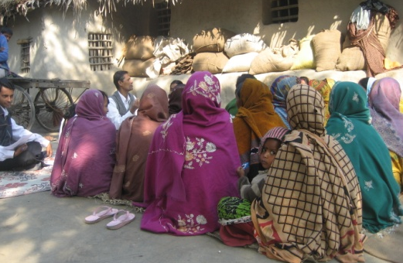
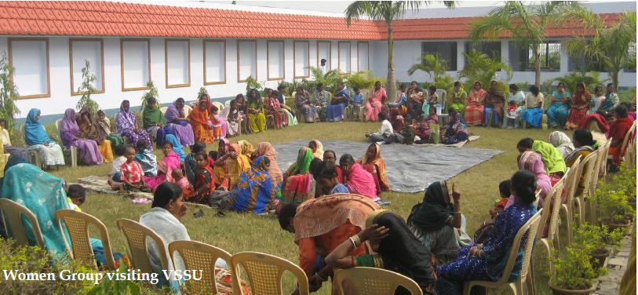
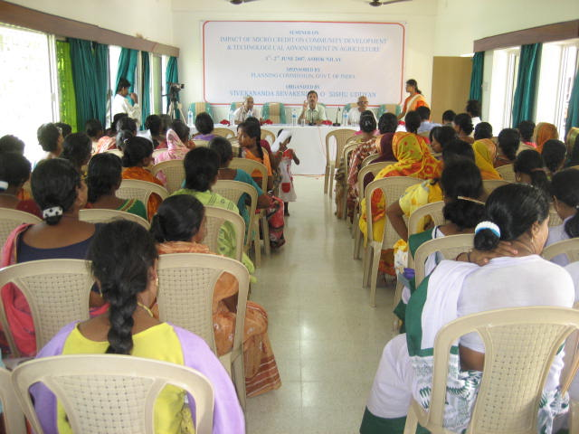
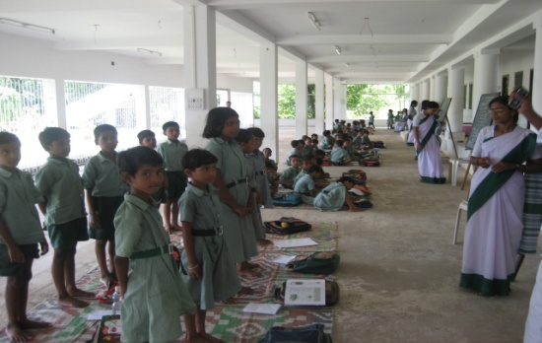
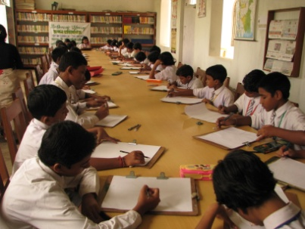
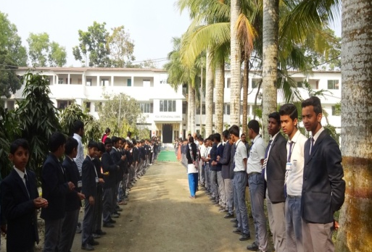
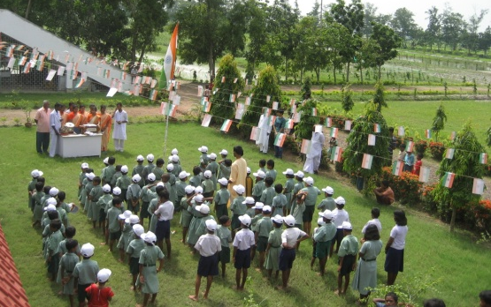
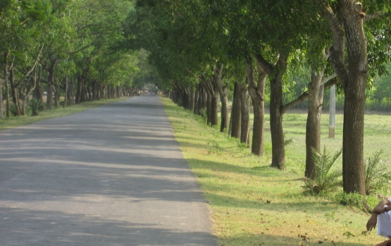
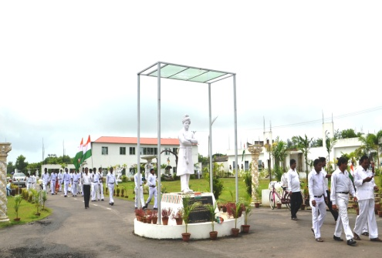
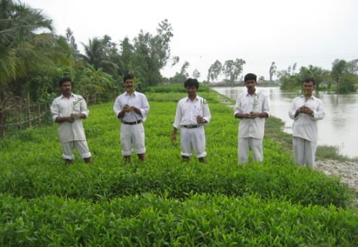
Vivekananda Sevakendra-O-Sishu Uddyan
( Activities at a GLANCE - 2021 )
Poverty Alleviation Programme.
Self-Help Group Meeting
Women of Self-Help Group visiting VSSU
Business Dev training for SHGs
Education:
Crèche & Preprimary school Programme
Community Library & VIS School
Home for Destitute Children
140 km PWD & Village Roadside #10,00,000 Tree Plantation
Organic Farming & Nursery

Slide 6
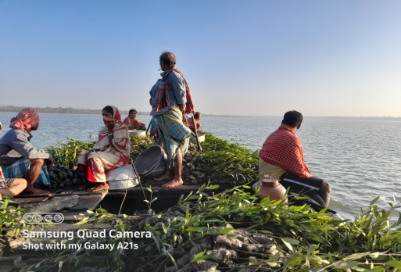
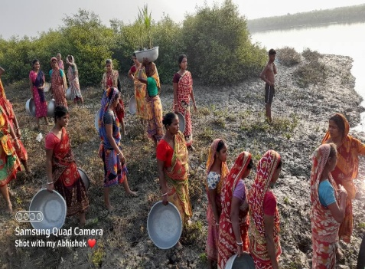
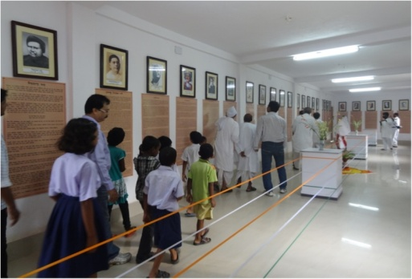
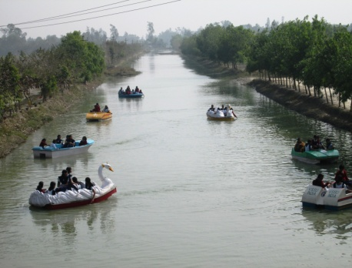
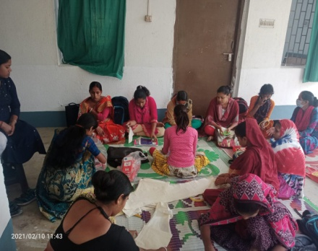
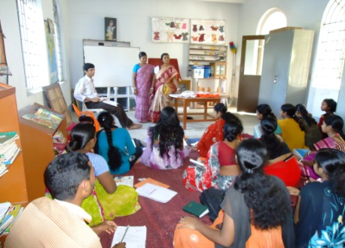
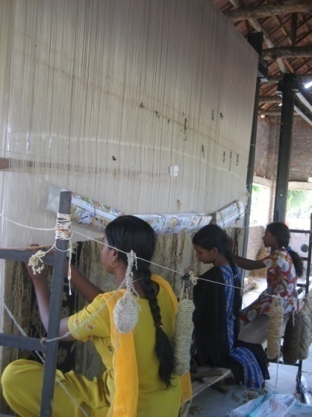
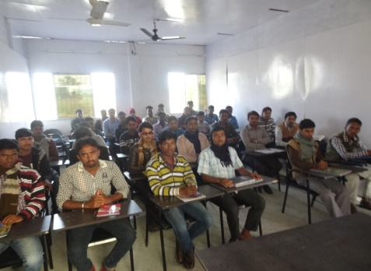
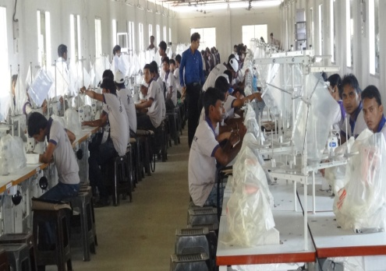
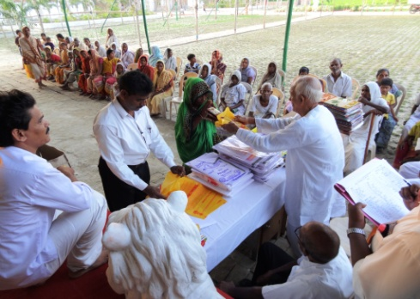
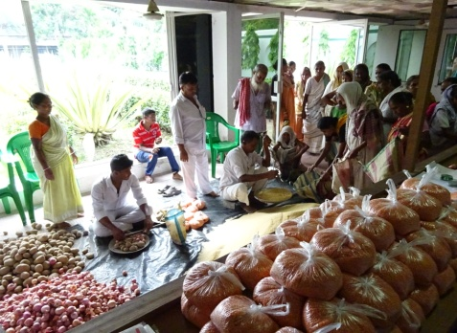
Social Forestry and Mangrove Restoration
Rural Tourism & Rain Water harvesting project
Mangrove Plantation & Conservation for Sunderban
Great men Gallery & RAIN water harvesting unit
Vocational Training prog for Women
Tailoring training Computer training
Carpet Weaving..
Skill Development for youth and women
Food Prog. For Under privileged
Rain water Harvesting
Residential Skill Training center for 5000+ trainees
Old age relief programmes
Distribution of Rice & pulse monthly basis.

Slide 7
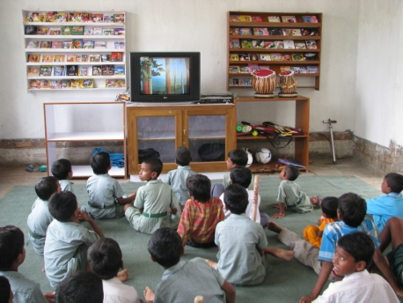
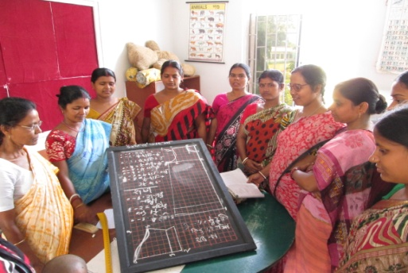
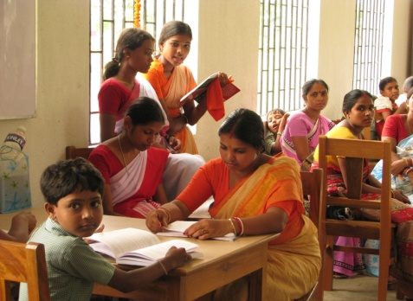
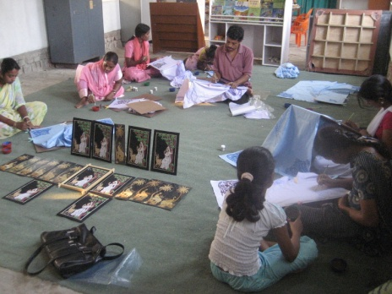
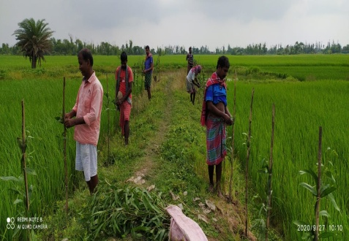
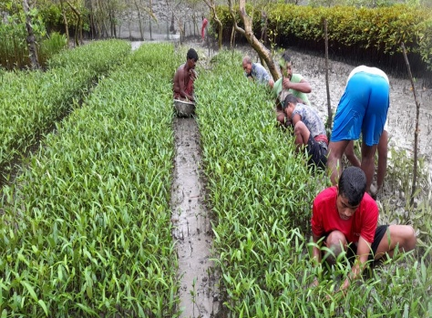
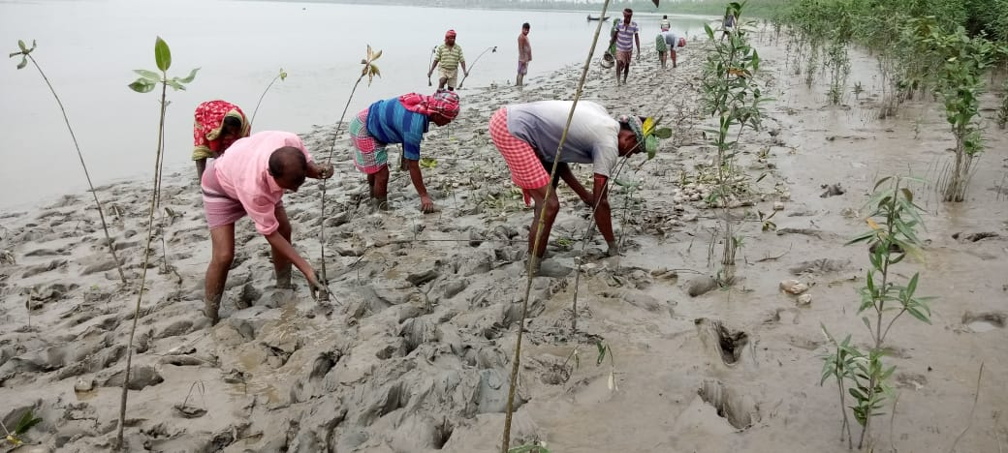
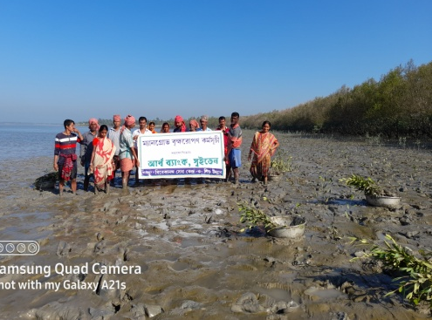
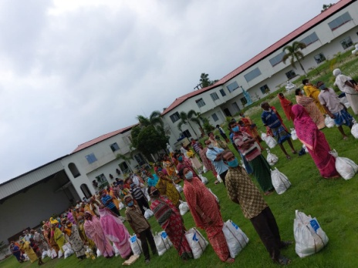
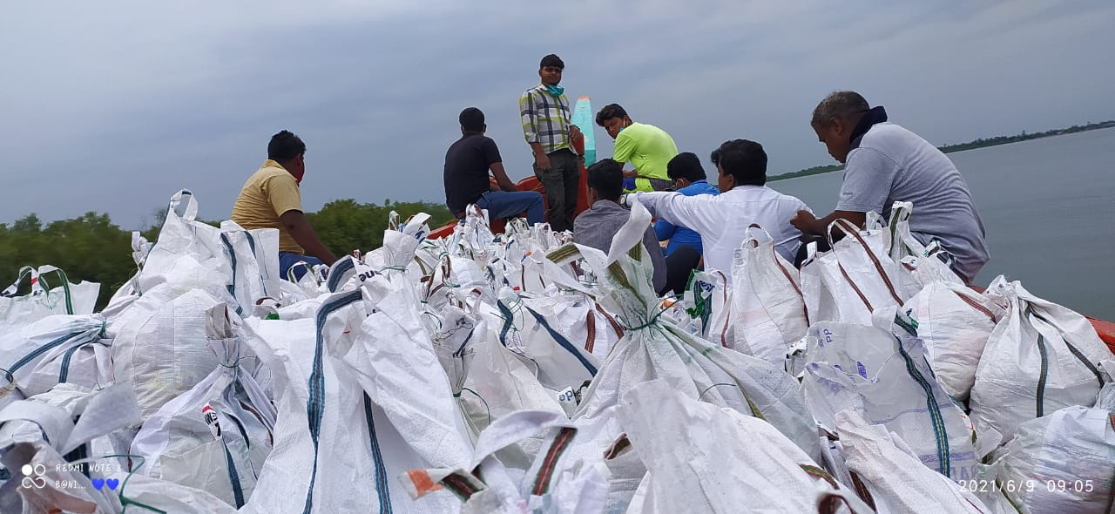
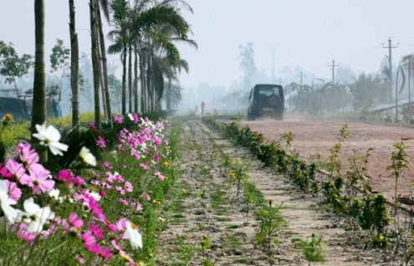
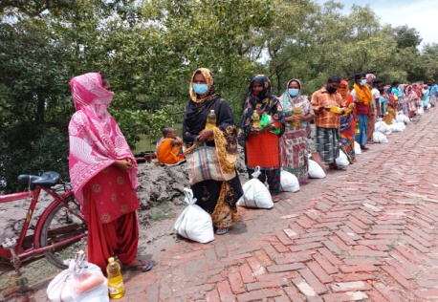
Activities at a GLANCE - 2021

Slide 8
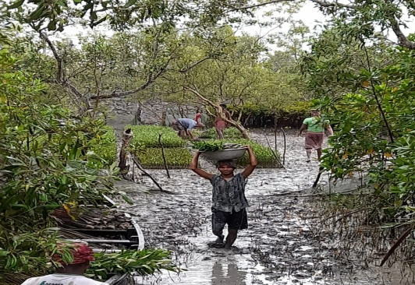
VSSU’s Plantation & developmental programme

Slide 9
VSSU’s Programme At Sunderban

Slide 10
Glimpse of programmes dedicated to Coastal Area
Programme | SUPPORTED BY | FY
VSSU has closely worked with Sunderban development Board for Strip Plantation of Mangrove & Wood species at Canning bridge Side . | Dept. Of Sunderban Affairs Govt. of WB | 2011-12
Wild Honey bee project impacted lives of 200 tribal families of Sunderban Paschim Dwarika Pur , pathorprotima | World Bank through ICAR | 2010-13
Distribution of #300 Pull VAN & financial support to the women for livelihood development at Gobindapur abad of pathor protima | ONGC - Mumbai | 2007-08
VSSU’s Scoail forestry programme & Mangrove restoration programme at Pathorprotima, L Plot & Dayapur, | VSSU own fund & Earthbanc -Sweden | 1986 To till date
VSSU’s innovative poverty alleviation & Women empowerment program has been praised by WORLD Bank & UNITED NATION’S ECOSOC. | UTI, SBI & SIDBI , CAPART, NABARD , | 1994- till date
COVID-19 relief to 2000 families and alternative livelihood promotion – Vocational training to coastal women of Mathurapur II block. | SEWA international , and READ Global | 2020-21

Slide 12
VSSU’s Accreditations and Recognitions …
2003 – ”International Microfinance can learn from VSSU ..”-World Bank study report ( 56pgs )
2011 - VSSU was granted “Special Consultative status“ by the UNITED NATIONS (ECOSOC)
“To support the holistic development of the Indian community in a self sustainable manner, and in particular, through
micro finance project & various community development programmes”
2012 – VSSU organized “International Brotherhood Conference” on 150th anniversary of Swamiji’s where delegates from 14 countries
from 4 continent attended and delivered their valuable speech on MDGs.
2013 - BBC, CNN & UN representatives visited VSSU to cover its Self sustainable Rural Dev. Prog. which were published World wide
- 350+ Interns /research fellow/delegates from 55 countries of 5 continent visited VSSU to study a innovative micro fin. Model.
CEO with Mr. S. Ratherford SOCIAL REPORT UNITED NATIONS PROG Intl. Brotherhood conference Press release Interns & exposurers
Kapilananda Mondal , the founder & CEO of Vivekananda Sevakendra O Sishu Uddyan (VSSU), a philanthropic dreamer , innovator and
social reformer from farmers family, has been a visionary and an enterprising person who has received many awards for his outstanding work on
promotion of microfinance, women empowerment , educational and social development in rural Bengal. He is relentlessly working since last 30
years and has been able to impacted 130,600+ direct families through his self sustainable rural dev. Model..
The man behind the organisation – Kapil Mondal
- Ashoka Fellowship for innovation on Micro banking from Washington DC , USA
2006 - Noble Laureate Md. Yunus stated, “ I am trying but Kapil have already achieved 100% loan from savings…”
Member WG. for 12th five yr plan ( 2012-2017 ), Planning Commission Govt. of India
2013 CEO was invited and attended American top Universities & colleges like MIT, Tufts, Sierra Nevada, Purdue, Calumet &
the college of Wooster etc in 8 states of USA to share his ideas “ Financing to the Poor ”
CEO got the opportunity to write an article “The future of Microfinance 2020” for “Convergence Barometer 2014” of France which was published both in French & English language , published in 201 partners website worldwide
Mr. Mondal have visited 23 countries (4 continent , 100% sponsored Prog) to share his unique model of social reformation…

Slide 13
“SAVING SUNDERBAN”
The Sundarbans, literally 'Beautiful forest', the world's largest mangrove delta, is spread over the southern end of both West Bengal (India) and Bangladesh. An UNESCO heritage site , the largest remaining natural habitat of the Bengal tiger, and It is the only mangrove habitat in the world for Panthera-Tigris species.
The Sunderban not only acts as a shield from natural disasters, but also protects the biodiversity and geological features of the region and the 6 Million livelihood of people. That's why We jointly need to take the highest measures possible to protect this unique forest.

Slide 14
The Challenge
Nearly half of the world’s population- some 3.5 billion people lives near coasts. And 6 Million people lives near Sunderban of India , As climate change exacerbates the effects of storms, flooding and erosion, the lives and livelihoods of those millions of those people will be at even greater risk. Nature makes communities more resilient to the impacts of climate change, reefs, dune and marshes break waves, absorb storm surges and blunt winds, greatly reducing risk to people and businesses.

Slide 15
Climate Change Impact
The impacts of climate change include more extreme weather and natural disasters, Super cyclones, droughts & economic instability.
To match the urgency of this crisis, we're deploying innovative solutions like Mangrove restoration, conservation, alternative livelihood promotional activities that maximize nature's ability to fight climate change while bolstering resilience for our most precious ecosystems and vulnerable communities of Sunderban.

Slide 16
Importance of Embankments
The Sunderban Delta area in South 24 Pgs has been characterized with frequent hydro-meteorological hazards like cyclone and storm surges effective upon the breaching of embankments.
The 3500 km long coastline of West Bengal is dominated by the Ganga -Brambhaputra delta which occupies around 60% of this coastline. In the entire Sunderban area embankment are the crucial for the existence of settlement on the deltaic island ,
The embankments protect the natural as well as cultural ecosystems as guard wall against waves and surges. Frequent breaching of such guard walls affects severely the livelihood of the rural people and cause the loss of life and property and damages naturally rich, eco-sensitive estuarine ecosystem of the riverine delta.

Slide 17
Facts - Sunderban Embankments
Officially 9 out 13 blocks of Sundarbans in the South 24 Pgs district have been identified to have potentially weak embankments due to natural shocks and fishery problems. The most vulnerable blocks are Basanti, Gosaba, Patharpratima, Mathurapur II, Namkhana and Sagar.
Type of embankment: We observed four main types of embankments can be seen along the different river side. ..
Earthen embankment.
Earthen embankment with bamboo fence.
Earthen embankment with bamboo fence and sand fill sag along the embankment.
Boulder pitching or concrete pitching embankment.
Trend of Embankment Breaching:
The trend of embankment of breaching if we look, we find that in different blocks the length of damage of embankment gradually increases year after year. Human activities, huge population pressure, tidal impact, unscientific method of embankment construction etc are responsible for embankment breaching.

Slide 18
Mangrove can be a Effective Solution for protection of coastal areas
Mangroves reduce annual flooding to more than 18 million people.
Without mangroves 39% more people would be flooded annually, and flood damages would increase by more than 16% and US $82 billion annually.
Vietnam, India, Bangladesh, China, and the Philippines received the greatest benefits from mangroves in terms of avoided flooding of people.
Mangroves can be managed as natural coastal infrastructure, either alone or in concert with built coastal infrastructure solutions, to substantially reduce exposure from coastal hazards.

Slide 19
Mangrove can be a Vegetative Solution for Ecology & Climate Change
Mangroves are important to the ecosystem too. Their dense roots help bind and build soils. Their above-ground roots slow down water flows and encourage sediment deposits that reduce coastal erosion.
Mangroves are natural barriers against climate disasters and help hold back the strong blows of the high tidal waves. The river embankments are protected as the roots of mangroves grip the earth and prevents landslides.
The complex mangrove root systems filter nitrates, phosphates and other pollutants from the water, improving the water quality flowing from rivers and streams into the estuarine and oceanic environment.
Mangrove forests capture massive amounts of carbon dioxide emissions and other greenhouse gases from the atmosphere, and then trap and store them in their carbon-rich flooded soils for millennia.
This is an important ecosystem service as we face climate change This buried carbon is known as “blue carbon” because it is stored underwater in coastal ecosystems like mangrove forests, sea grass beds and salt marshes.

Slide 20
Species to Plant to protect Soil erosion
Garjan , Bain , Boyan , kankram Genwa pashur , Vara etc. especially those trees that have complex mangrove root systems as their dense roots will help to bind and build soils. Their above-ground roots slow down water flows and encourage sediment deposits that reduce coastal erosion
And will also help to filter nitrates, phosphates and other pollutants from the water will improve the water quality.

Slide 21
Mangrove can be a solution for to Protect Embankments
Mangroves are trees and shrub species that grow at the interface between land and sea in tropical and subtropical regions of the world, where the plants exist in conditions of salinity, tidal water flow and muddy soil.
The structural complexities of mangrove vegetation create unique environments which provide ecological niches for a wide variety of organisms. Mangroves serve as breeding, feeding and nursery grounds for most of the commercial fishes and crustaceans on which thousands of people depend for their livelihood.
Mangroves give protection to the coastline and minimize disasters due to cyclones and tsunami. Recent studies have shown that mangroves store more carbon dioxide than most other forests.
Mangroves are an intermediate vegetation between land and sea that grow in oxygen deficient waterlogged soils which have Hydrogen Sulfide (H2S). They perform important ecological functions like nutrient cycling, hydrological regime, coastal protection, fish-fauna production, etc.
Mangroves act as shock absorbers. They reduce high tides and waves and help prevent soil erosion. They also provide livelihood opportunities to coastal communities.

Slide 22
GOAL of this project :
To ensure the long-term survival of the biodiversity and ecological sustainability of Sunderban .
To Conserve The mangrove & maintain Ecological Sustainability
To Protect The earthen Embankments with a vegetative Approach
To Provide Alternative livelihood for the Inhabitants of Coastal Area

Slide 23
Nature Based Solutions
Nature plays a major role in regulating the climate by storing carbon dioxide. By conserving forests and wetlands, adding regenerative practices to agriculture and planting trees, we're unleashing nature's full potential to stabilize the climate.
The role of mangroves in coastal risk reduction is enormous, Wind and swell waves are rapidly reduced as they pass through mangroves, lessening wave damage during storms, The dense roots of mangroves help to bind and build soils. The above-ground roots slow down water flows, encourage deposition of sediments and reduce erosion.
Identifying, protecting and restoring areas that decrease flood risk can reduce the consequences of flooding — loss of life, structures and crops — and decrease repetitive economic losses.

Slide 24
Strategies for Protection of Coastal Areas & Earthen Embankments
Strengthening protection technology to prevent further deforestation and degradation of mangroves within the Reserved Forest boundaries.
Planting new trees in the villages, along the embankments and the degraded mangrove sites, to sequester carbon and provide protection to the embankments against storm surges and tidal erosion
Stop conversion of mangrove areas into brackish water aquaculture ( preferably shrimp culture)
Identify , Strengthen and maintain fragile embankments out of 3500 km long embankments around 54 non-forest islands.
Promoting Alternative livelihood options for inhabitants , to make them less dependent on forest , reduce their life risks following programmes like Apiary, Mushroom cultivation, Piggery, Goatary, Duckery, Poultry, Vocational training, formation of SHGs etc. can be introduced.
And a Large scale of Income generation can be created through involving the community in Seed collection, Nursery prog , Plantation of saplings and monitoring & restoration of the forest along side of Embankments through constructive Planning & management.

Slide 25
Strategies to become less dependent on forest
Since large section of the people, especially in the buffer zone of mangrove forest, depends on the natural resources of Sunderban estuary for their livelihood, developing alternate livelihood in the changed climate scenario is of paramount consequence.
Rain water harvesting in the villages through construction of irrigation channels and pond. The stored rain water can be used for drinking water as well as irrigation water for raising second crop in dry months
Encourage cultivation of salt-tolerant, indigenous varieties of paddy and vegetables which will act as insurance against the vagaries of rainfall and flood.
Alternative livelihood promotion to make the villagers less dependent on the mangrove forests, like fishing, tiger prawn seed collection etc, the village women folk are being trained up in village-based activities like sewing/ stitching, poultry/ duckery/ piggery and raising of seedlings for afforestation purpose.
Stress on cultivation of cash crops including chilly, sunflower etc which are less perishable and can be stored and marketed as per convenience.

Slide 26
Conclusion ..
Each year, 32 million acres of the world’s forests are lost. Together, we can save the landscapes that provide us with so much.
Thank you..

